Slide 1
Customer REcommendation System
From Customer Behaviours(Earning)

Slide 2
Group Information
Md Fahim Rahman
18201041
Md Mahir Bin Foysal
18201034
Moshiur Tanmoy
18201027

Slide 3
Brief About The Project
Many small businesses demands a more automation to increase the sales
Many business been doing this manually by reaching out to customer
The goal of this project is to make business more efficient by recommending customer for a certain types of product
This System will only receive commission based on the sale it
contributes to the business

Slide 4
Goals To
Achieve
Efficient and cost effective
Sharper recommendation for new inventory
Increased sales
Automated Process
Self developing mechanism
Adaptive Features
Easy to configure
Subscription based service

Slide 5

Customer Demand
In a recent Survey
Rarely Shops From Recommendation
14%
Always Shops From Recommendation
80%
Never Shop from Recommendation
6%

Slide 6
Possible Complications
Can be done manually
Privacy Concerns
For a small business and small inventory it may prove ineffective
Data harvesting may pose a great risk about privacy as customer information is being collected
Data Mining
For storing large amount of data and accessing real time, cost may increase in case of number of servers

Slide 7
1. Operational
2. Technical
3. Economic
4. Legal
5. Schedule
Feasibility Analysis
Up Ahead

Slide 8
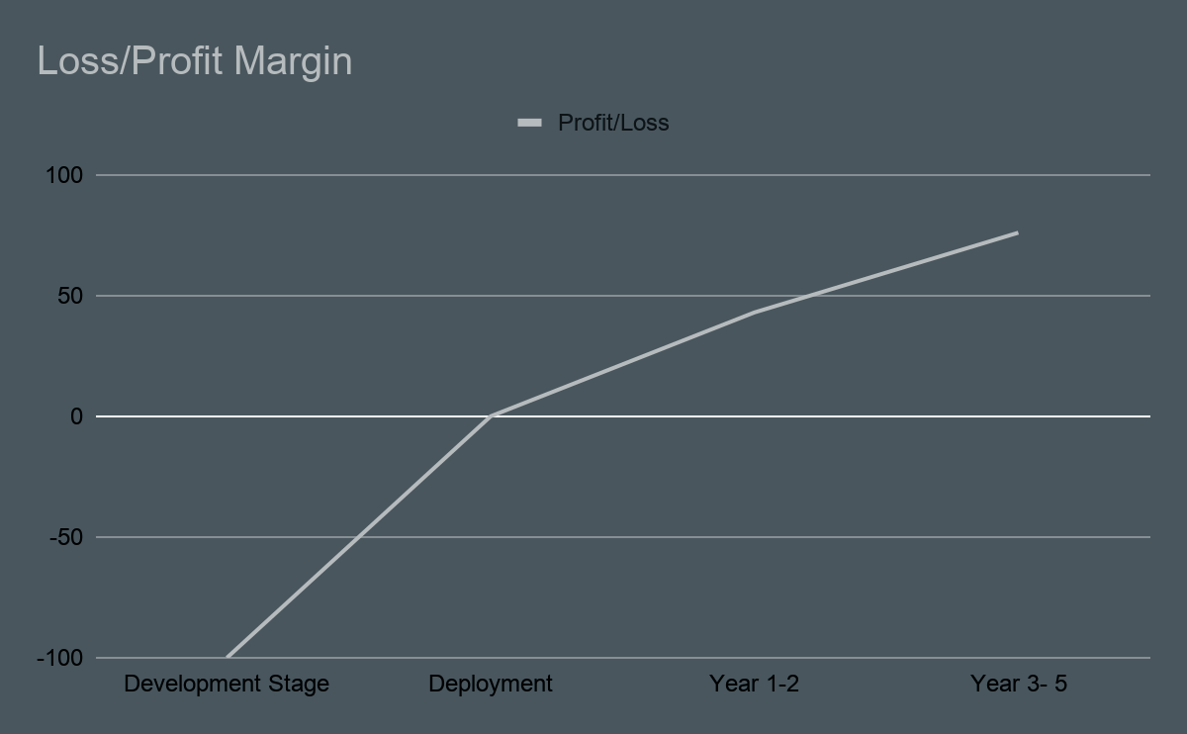
Economic Feasibility
The economic feasibility step of business development is that period during which
a break-even financial model of the business venture is developed based on all costs associated with taking the product from idea to market
and achieving sales sufficient to satisfy debt or investment requirements

Slide 9
Schedule Feasibility
Schedule Feasibility is defined as the probability of a project to be completed within its scheduled time limits, by a planned due date. If a project has a high probability to be completed on-time, then its schedule feasibility is appraised as high.
Project Estimation
Gantt and PERT charts
Software Development
Change Management
No FIxed Date
9/2/2021
One Month
23/3/2021
Two Weeks
23/9/2021
Five to Seven Months

Slide 10
TEchnical Feasibility
Technical feasibility analysis is an attempt to study the project basically form a technician’s angle. The main aspect to be considered under this study are technology of the project.
● Size of the plan.
● Location of the project
● Production capacity of the project
● Strength of the Project
● Hardware and Software requirement of the proposed system.

Slide 11
Conclusion
Considering real life scenarios all the features stated before may not be achieved but this project aims to make a better and more efficient business tool

Slide 12
THANKS

